Slide 1


CMR Technical Campus
Department of CSE
Kandlakoya , Medchal Road,Hyd-501 401 Department of Computer Science Engineering
Industrial Oriented Mini Project on
PROJECT TITLE :
Design of a Smart Home Door Security System with Face Detection and Smart Bell using ESP32- CAM
Project Coordinator:
Name: Dr Mantesh Patil
Designation: Associate Professor
Project Guide:
Name : Dr J Narasimharao
Designation: Associate Professor
Presented By:
Batch No: 06
H. No: 237R1A05R6 Name: Yarra Harshini
H. No: 237R1A05K4 Name: Anand Kasoju
H. No: 247R5A0521 Name: Agidi Akshitha

Slide 2
Vision:
DEPARTMENT VISION AND MISSION
To Provide quality education and a conducive learning environment in computer engineering that foster critical thinking, creativity, and practical problem-solving skills.
Mission:
1. To educate the students in fundamental principles of computing and induce the skills needed to solve practical problems.
2. To provide State-of-the-art computing laboratory facilities to promote industry-institute interaction to enhance student’s practical knowledge.
3. To Inculcate self-learning abilities, team spirit, and professional ethics among the students to serve society.

Slide 3
INDEX
Project definition
Objective of the project
Literature survey
Proposed methodology
Block diagram
Tools and technology
Expected output

Slide 4
PROJECT DEFINITION
The Smart Home Door Security System with Face Detection and Smart Bell using ESP32-CAM is an IoT-based embedded security system designed to enhance home safety by automatically detecting and monitoring visitors at the door. The system uses the ESP32-CAM module, which integrates a microcontroller, camera, and Wi-Fi connectivity, to capture images of visitors when motion is detected or when the doorbell is pressed.
The captured image is processed using face detection algorithms and then transmitted through a wireless network to the homeowner’s mobile device or cloud platform. This allows the user to remotely monitor visitors, verify identities, and receive real-time alerts, improving both convenience and security.
The system combines embedded systems, computer vision, and Internet of Things (IoT) technologies to create a low-cost, compact, and intelligent alternative to traditional doorbells and CCTV-based security systems.

Slide 5
OBJECTIVE OF THE PROJECT
To design and develop a smart door security system using the ESP32-CAM module for modern home security.
To implement face detection technology that can detect and capture the image of a person approaching the door.
To provide real-time alerts to the homeowner through Wi-Fi communication when a visitor arrives or presses the doorbell.
To integrate a smart doorbell system that captures images automatically when the bell is pressed.
To create a low-cost and energy-efficient security solution suitable for smart home applications.
To enable remote monitoring so that the homeowner can view visitor images from anywhere using a mobile device or cloud platform.
To improve safety and convenience by reducing the need for manual monitoring and traditional door security systems.

Slide 6
LITERATURE SURVEY
Ref | Work / System | Approach | Offline? | Multi-Modal? | Limitation | Year
[1] | Smart Door Lock System Using Face Recognition and IoT | Face recognition + IoT monitoring | No | Face only | High computational resources, hard for low-cost devices | 2021
[2] | IoT-Based Home Security System Using ESP32-CAM | ESP32-CAM video streaming + motion detection | Yes | Camera only | No full face detection | 2022
[3] | Face Recognition-Based Smart Security System for Smart Homes | OpenCV face recognition + door control | No | Face only | Needs external processing unit | 2020

Slide 7
LITERATURE SURVEY
Ref | Work / System | Approach | Offline? | Multi-Modal? | Limitation | Year
[4] | Intelligent Doorbell System with Image Capture and Mobile Notification | Camera capture + mobile alert | No | Image only | No face recognition | 2019
[5] | Embedded Face Detection System Using ESP32-CAM for Access Control | Face detection on ESP32-CAM | Yes | Face only | Limited memory & processing power | 2023
Ours | Smart Door Lock Using ESP32-CAM with Face Detection | ESP32-CAM + Face detection + IoT alert | Yes | Face + IoT | None identified | 2024

Slide 8
PROPOSED METHODOLOGY
The proposed system is designed to enhance home security using the ESP32-CAM module, which integrates a microcontroller, camera, and Wi-Fi connectivity. The methodology focuses on detecting visitors at the door, capturing their image, and sending real-time notifications to the homeowner.
1. System Setup
The system consists of the ESP32-CAM module, a smart doorbell switch, a power supply, and a Wi-Fi communication network. The ESP32-CAM acts as the main controller and image processing unit.
2. Visitor Detection
When a person approaches the door or presses the smart doorbell, the system activates the camera module. This triggers the ESP32-CAM to start capturing an image of the visitor.

Slide 9
3. Image Capture and Face Detection
The ESP32-CAM captures the image and processes it using face detection algorithms. The system checks whether a human face is present in the captured image.
4. Data Transmission
Once a face is detected, the captured image is transmitted through the Wi-Fi network to the homeowner’s mobile device or cloud platform.
5. Real-Time Notification
The homeowner receives a notification along with the visitor’s image, allowing them to identify the person at the door remotely.
6. Remote Monitoring
The homeowner can view the visitor’s image and decide whether to respond or grant access. This provides remote monitoring and improved home security.
7. System Advantages
The methodology provides a low-cost, compact, and efficient smart security solution by combining embedded systems, IoT communication, and face detection technology.

Slide 10
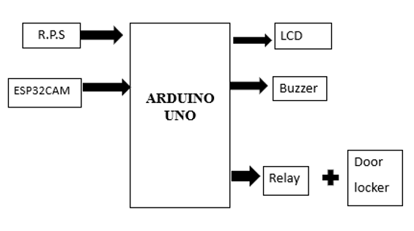
BLOCK DIAGRAM

Slide 11
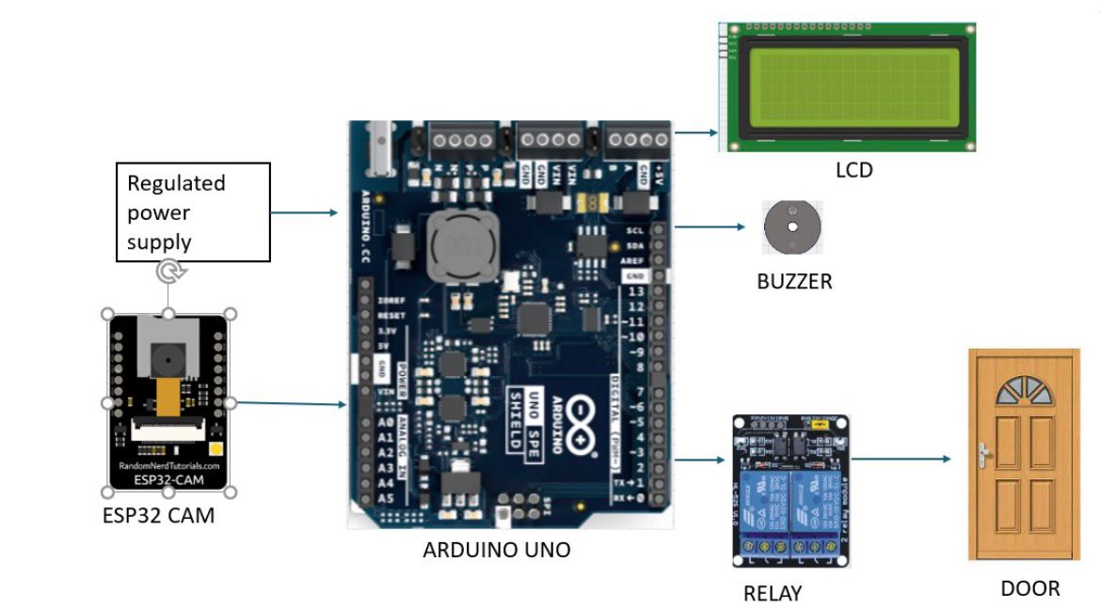
BLOCK DIAGRAM

Slide 12
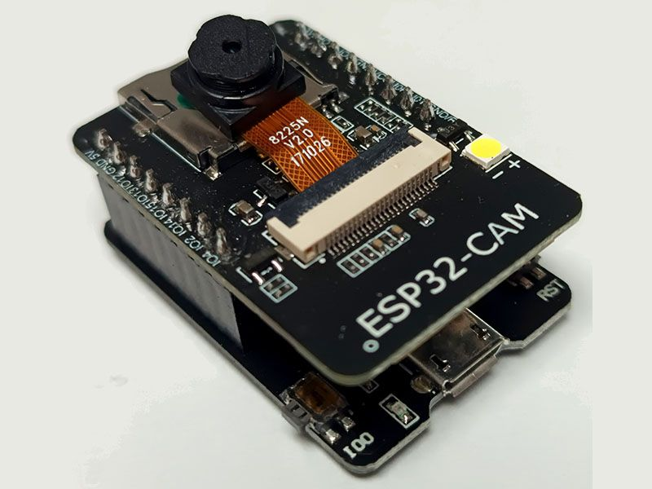
TOOLS AND TECHNOLOGY
ESP32-CAM
The ESP32-CAM is the core component of the system. It combines a microcontroller, camera interface, and Wi-Fi connectivity in a single compact module.
Role in the project:
Captures images of visitors.
Performs face detection processing.
Sends images and alerts to the homeowner
using Wi-Fi.
Key features:
Built-in Wi-Fi and Bluetooth
OV2640 camera support
Low power consumption
Suitable for IoT applications

Slide 13
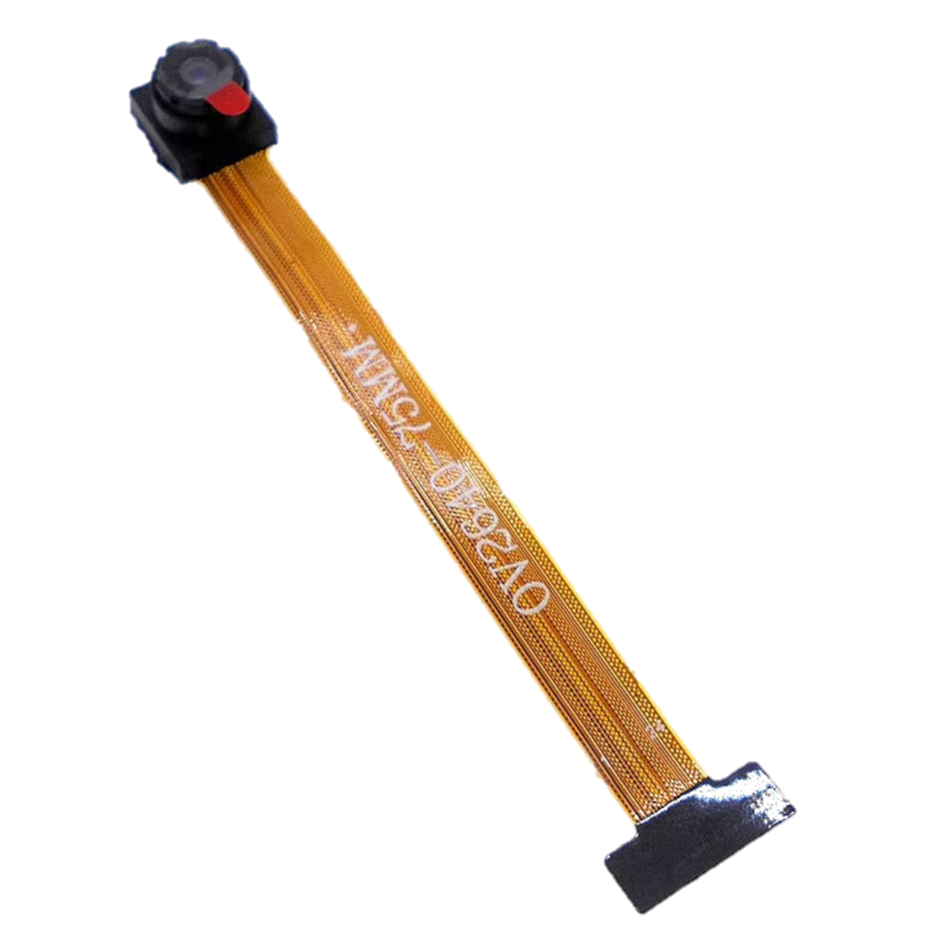
TOOLS AND TECHNOLOGY
2. Camera Sensor (OV2640)
The OV2640 camera sensor captures images of the person standing near the door.
Role in the project:
Takes pictures when motion is detected or the
doorbell is pressed.
Sends image data to the ESP32-CAM for processing.
Features:
2-megapixel camera sensor
Supports JPEG compression
Low power image capture

Slide 14
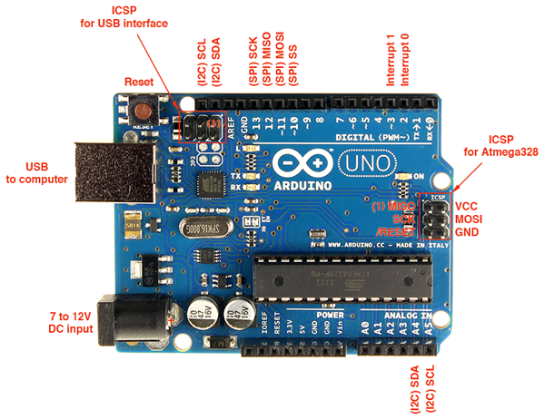
TOOLS AND TECHNOLOGY
3. Arduino Board (Arduino Uno)
The Arduino IDE is the development environment used to program the ESP32-CAM.
Role in the Project
Acts as a microcontroller platform for controlling electronic components.
Can be used to interface sensors, buttons, LEDs, and other hardware modules.
Helps in testing and developing embedded applications before integrating with advanced modules like ESP32-CAM.
Key Features
Microcontroller: ATmega328P
Operating Voltage: 5V
Digital I/O Pins: 14 (6 PWM pins)
Analog Input Pins: 6
Flash Memory: 32 KB
Clock Speed: 16 MHz
USB Interface: Used for programming and
communication.

Slide 15
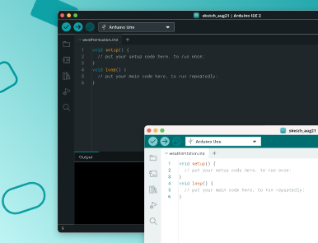
TOOLS AND TECHNOLOGY
4. Arduino IDE (Software Tool)
The Arduino IDE is the development environment used to program the ESP32-CAM.
Role in the project:
Writing and editing program code.
Compiling and uploading code to ESP32.
Monitoring system output through the serial monitor.
Programming language used:
Embedded C / Arduino language

Slide 16
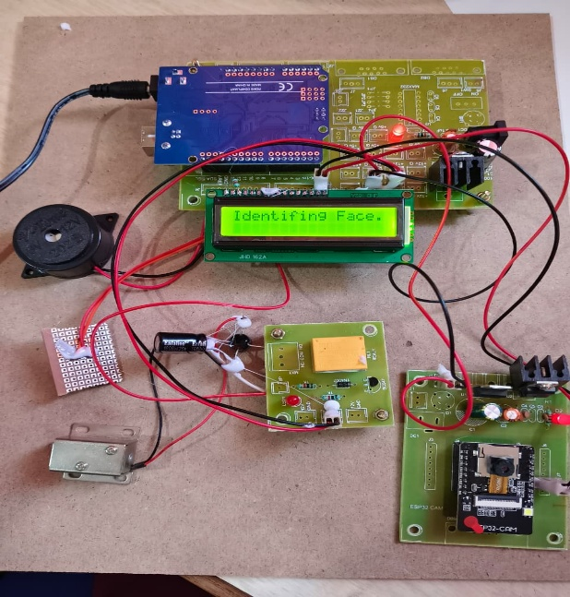

Slide 17
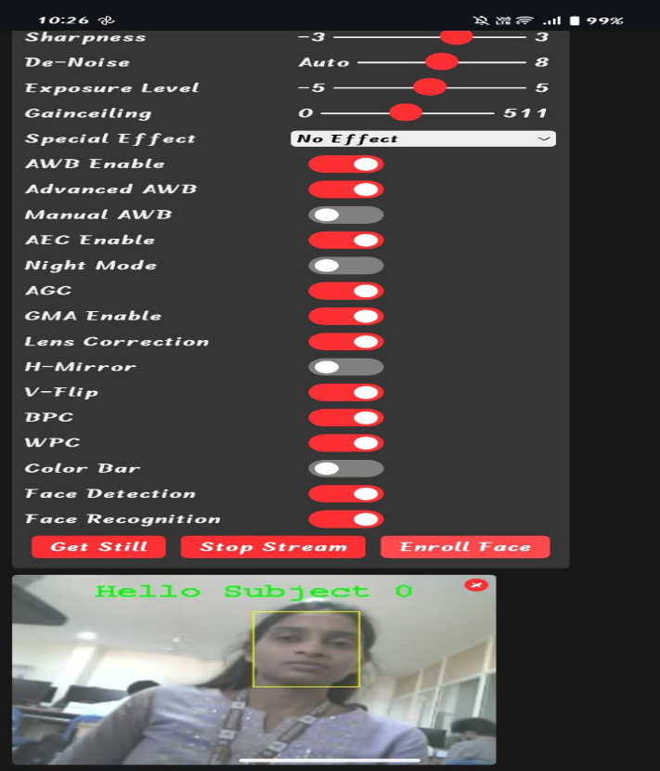
EXPECTED OUTCOME

Slide 18
Thank You

